Slide 1

Data Science Neighbourhoods Analysis for Restaurant - Manchester
DCJ
Applied Data Science Capstone IBM

Slide 2
Introduction
Love football, would like to live there and see potential for restaurant
Biggest cities of uk and big population
People from all around the world

Slide 3
Business Problem & Data
Would like to see the oportunity for opening a restaurant and what neighbourhood would be the most likely to do it.
Have the venue data for the Foursquare API
Have also the geographical coordinates of the neighborhoods, using GeoPy Library
Will retrieve the information about the neighbourhoods of Manchester through the Wikipedia page through data scraping

Slide 4
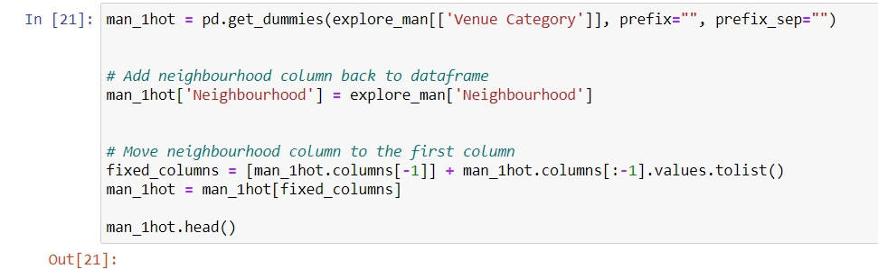
Methodology
Feature Extraction: One hot encoding

Slide 5
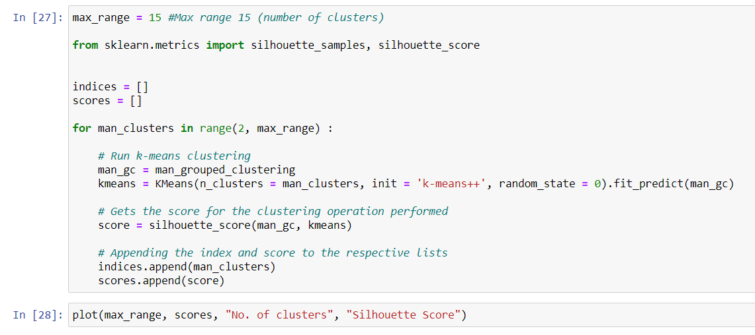
Methodology
Unsupervised Learning: K- Means Klustering

Slide 6
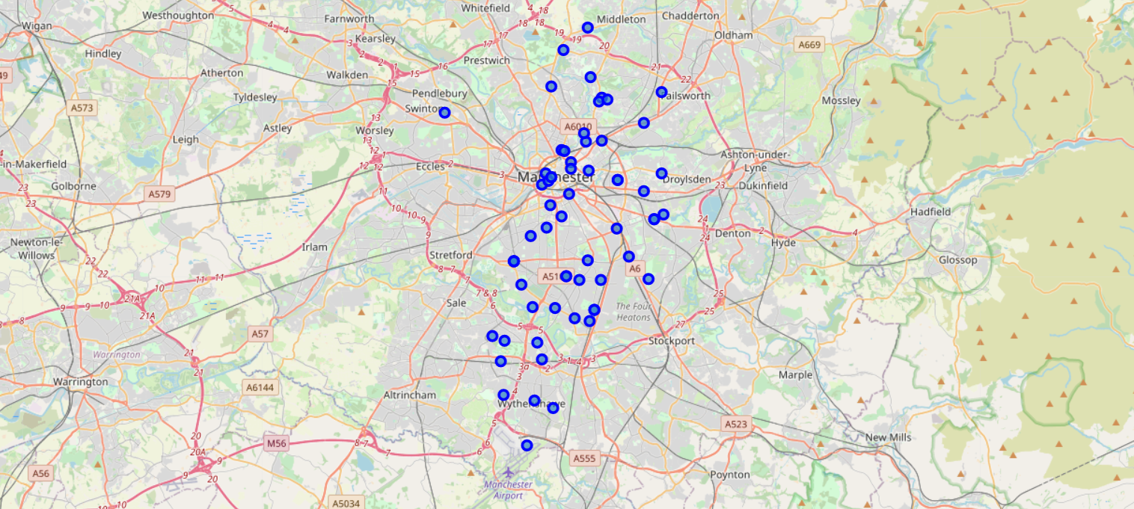
Methodology
Plotting: Folium

Slide 7
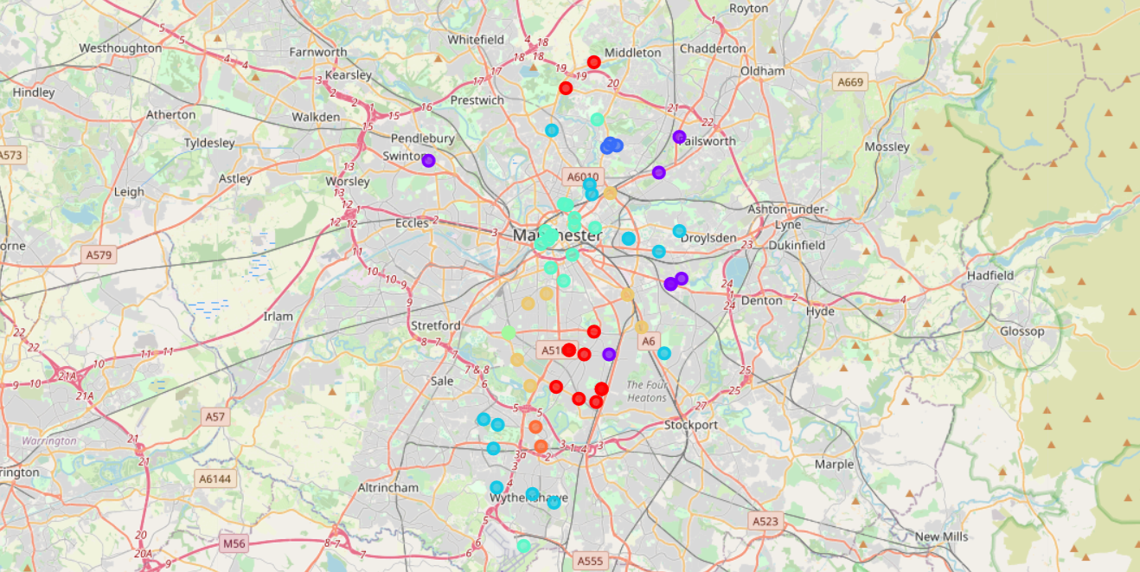
Results
Visualization of the Clusters

Slide 8
Business Discussion & Conclusions
The client that would like to carefully decide and have into account all other factors to take a decision. Data analysis and machine learning were the principles to assist on decision making.
After studying all of the four clusters it is recommendable to have an interest in setting up a restaurant and the best possibilities would be Barlow Moore or Brooklands, that fall into cluster four and if somebody is interested in opening a restaurant this information would be useful. For this conclusions, Python’s inbuilt libraries such as BeautifulSoup, Folium and GeoPy were key to be able to determine.
As mentioned, cluster 4 would be very attractive for opening a restaurant.
The K-Means model worked really well and was successful in the clustering exercise.

